Slide 1
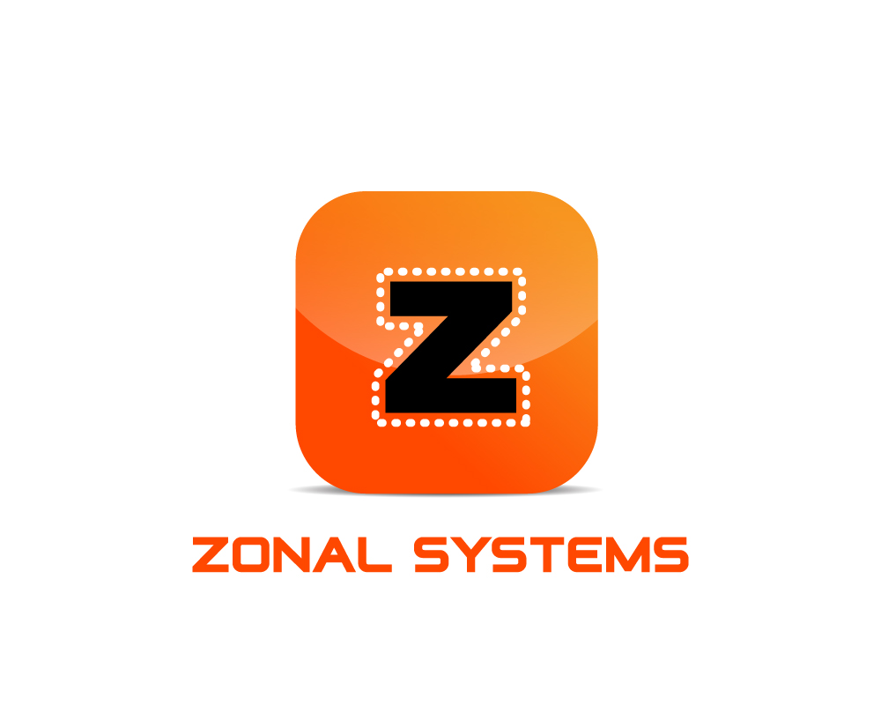
Zones anywhere for any purpose for everyone

Slide 2

Confidentiality
The information contained in this presentation is proprietary and confidential to Zonal Systems Llc. and should not be disclosed to any third parties without the express permission of Zonal Systems Llc.
Copyright 2016 Zonal Systems Llc.
All Rights Reserved

Slide 3

Owners
Robert Pierce Ph. D. SMU, Computer Science
James “Chip” Northrup, BA SMU, MBA Wharton

Slide 4
Why Zonal ?
One app for any space for everyone
Zone from the state line to the next step
Multiples functions in a zone
User opts into the zone – not tracked

Slide 5
What are Zones ?
Virtual interactive geo-enclosures
Created by anyone – accessible by everyone
Can overlap same area
Displayed on mobile device and computer
App controls functionality in zone

Slide 6

How do Zones Work ?
Zones are created on a PC on an online map
Phone user gets the Zonal app
Zone coordinates are downloaded to mobile device
Zone boundaries displayed on mobile device
User accesses any zone with one app

Slide 7
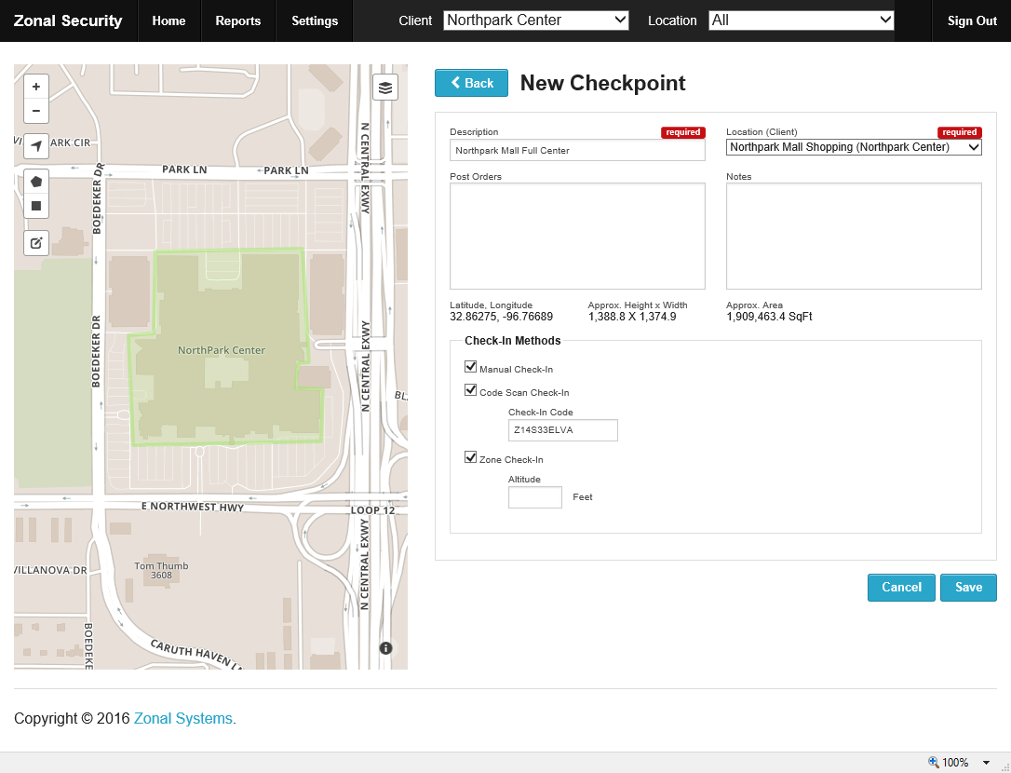
Zone Created on a PC
Zonal Shopping
Zone Around Mall
(in green)

Slide 8
Zone Drawn and Marked

Slide 9
Zone May be Registered in Cloud

Slide 10
User Gets Zone Coordinates From Marker

Slide 11
User Gets Zone Coordinates From Cloud

Slide 12
User Enters Zone and Interacts

Slide 13
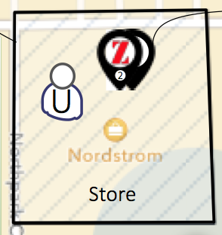
Same Zone, Many Uses
Zone can have multiple uses
  Local social
  Promotions
  Bulletin board
  Store information
  Supervisory
  Machine control
Zone index lists uses

Slide 14
Reasons for Zones
More cost-effective than proximity systems
Where an activity must be geo-enclosed
Mobile gaming
Where an activity should be geo-enclosed
Hyper-local social

Slide 15
Zones vs Competition
Most Zones require no infrastructure
Zones can be set up anywhere in minutes
One app for any zone – by location, use, etc.
User controls the Zonal experience
Zones can replace or augment beacons

Slide 16
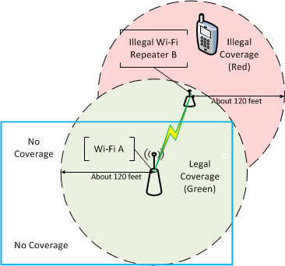
Where Proximity Fails
Don’t match boundary
Signal spills out of area
No coverage in corners

Slide 17

Zonal Phone App
Recruits smart device’s GPS
Owner creates 2D/ 3D/ or 4D zones
One app for any use for everyone
Patented solutions

Slide 18
What’s in Your Zone ?
Any size or shape
From the state line to a shelf on an aisle
Works indoors with no GPS reception
10cm accuracy in development

Slide 19
Who’s in Your Zone ?
Chat limited to users in zone
Log in with your social and find friends
Talk to Zone owner

Slide 20
What’s Zoned ?
Patents or patents pending on
Mobile gaming ✔️
Retail ✔️
Remote supervision ✔️
Interactive Zone map markers pat pend
Control of machines pat pend
Automated Zone creation pat pend
Moveable Zones – trains, buses pat pend

Slide 21
Zonal Systems Supervision IP
U.S. Patent 9,319,834 B2
“System and Method for Providing Automatic Supervision of Employees Using Virtual Geographic Zones”
Robert Pierce II & James L. Northrup
Assigned to Zonal Systems, Llc
April 2016

Slide 22
Zonal Systems Gaming IP
U.S. Patent 9,317,996 B2
“Method for Authenticating a Wager Using a System and Method for Interacting with Virtual Geographic Zones”
Robert Pierce II & James L. Northrup
Assigned to Zonal Systems, Llc
April 2016

Slide 23
Zonal Systems Retail IP
U.S. Patent 9,398,404 B2
“System and Method for User Interaction with Virtual Geographic Zones”
Robert Pierce II & James L. Northrup
Assigned to Zonal Systems, Llc
July 2016

Slide 24
Zonal Places App IP
U.S. Patent Application 15/277,915
“System and Method for Placing Virtual Geographic Zone Markers”
James L. Northrup & Robert Pierce II

Slide 25
Zonal Systems Contacts
Robert Pierce
pierce@zonalsystems.com
Chip Northrup
northrup@zonalsystems.com

